Slide 1





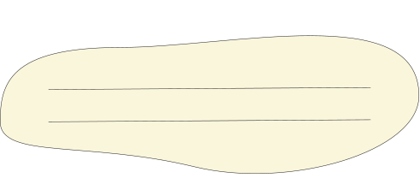
Github Link
https://github.com/24h247-glitch
thank you

